Slide 1

CS114 Introduction to Computer Programming
Fall, 2020

Slide 2

Introduction
Taha Ali
[taha.ali@seecs.edu.pk] [web page]
Assistant Professor,
Electrical Engineering,
Room 215, Academic Block
SEECS, NUST
Consultations: Wed. 2-3 pm or via appointment
1

Slide 3
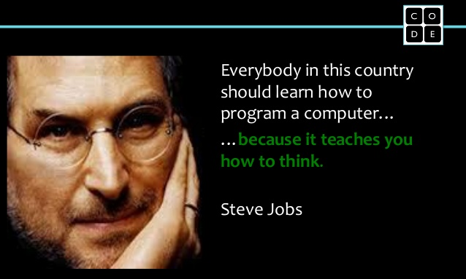
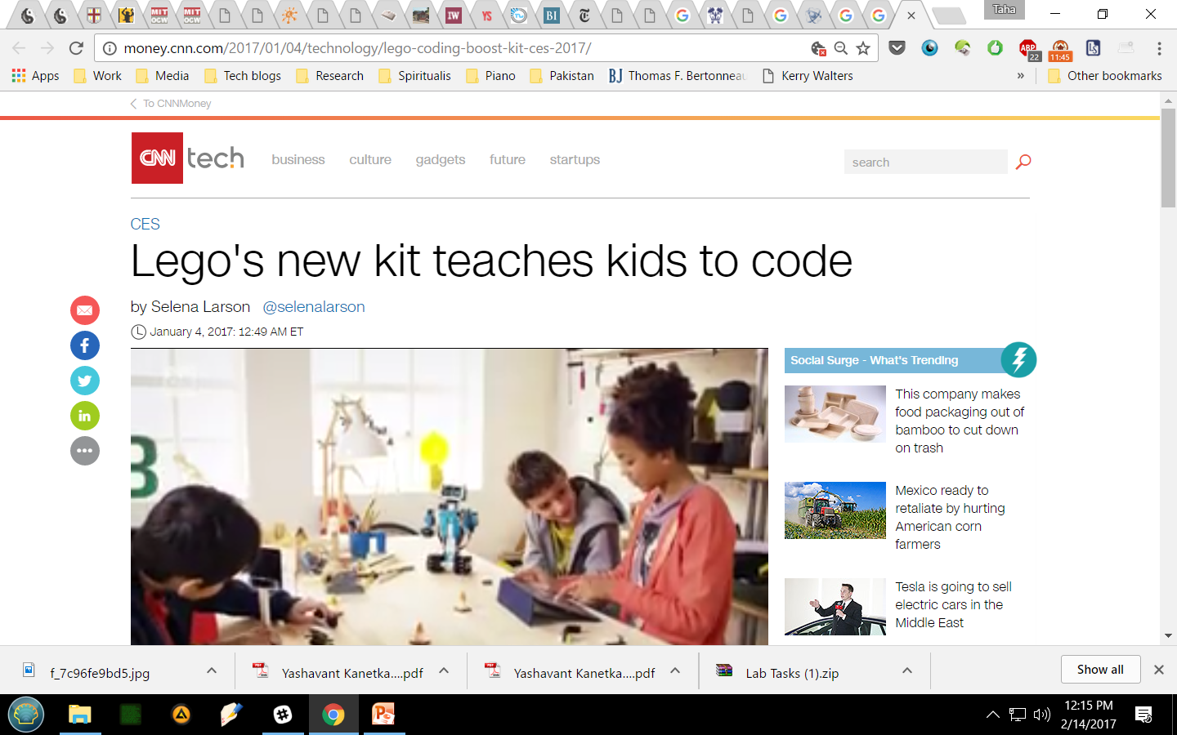
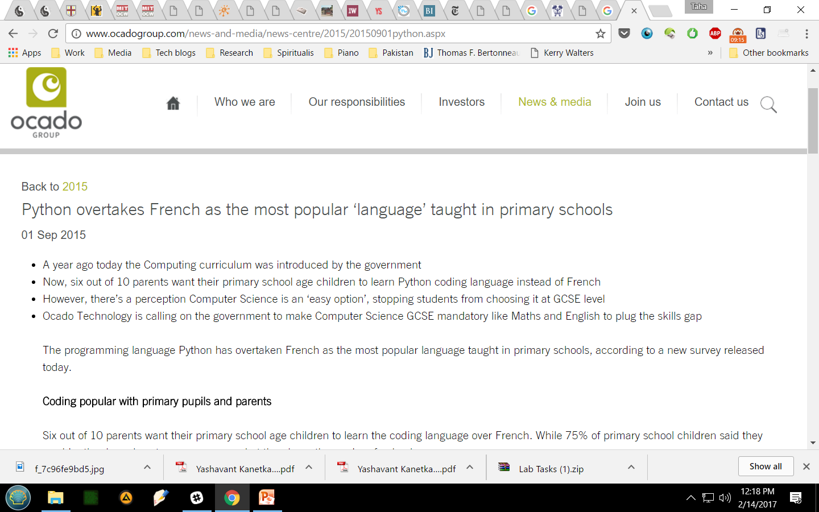
Why learn programming
2

Slide 4
motivation
Why study computer programming?
1) Used for computation, simulation and modelling, data processing, optimization, etc.
2) Vital skill for any engineering grad nowadays
3) Opens up high-tech specialized jobs
4) Absolutely vital for research career
5) Computers are changing everything
6) Good fun!
3

Slide 5
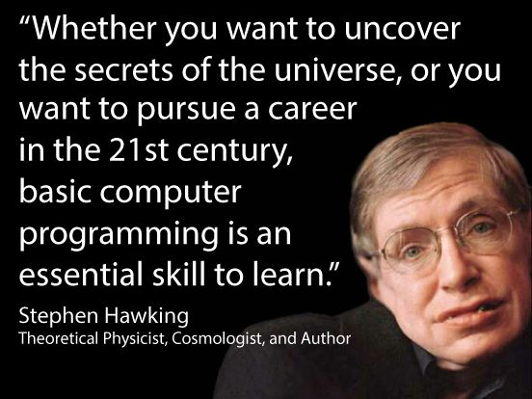

Example: big data
4

Slide 6
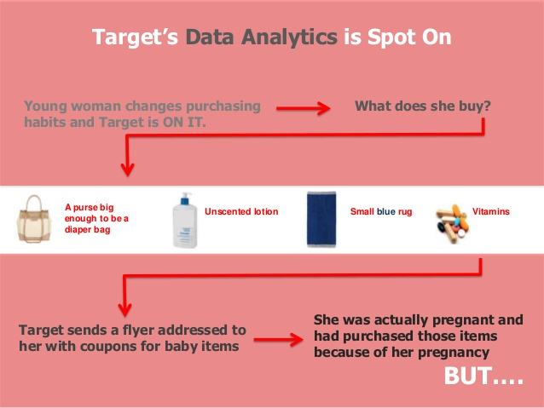

big data
“My daughter got this in the mail! ... She’s still in high school, and you’re sending her coupons for baby clothes and cribs? Are you trying to encourage her to get pregnant?”
On the phone, though, the father was somewhat abashed. “I had a talk with my daughter,” he said. “It turns out there’s been some activities in my house I haven’t been completely aware of. She’s due in August. I owe you an apology.”
… it was addressed to the man’s daughter and contained advertisements for maternity clothing, nursery furniture and pictures of smiling infants. The manager apologized and then called a few days later to apologize again.
How Companies Learn Your Secrets
5

Slide 7
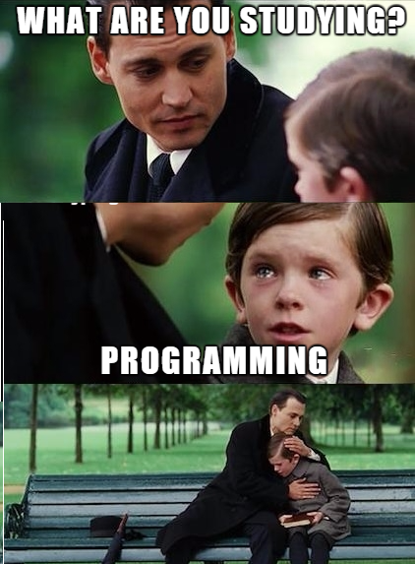
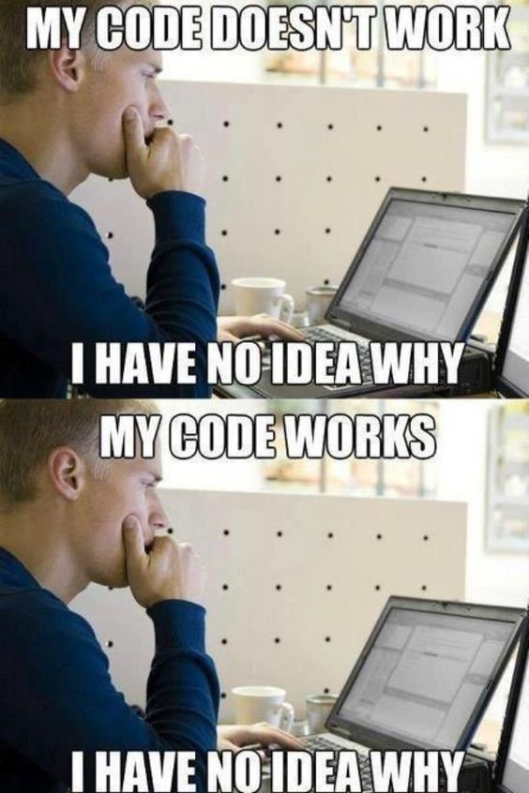
Programming is not easy
6

Slide 8
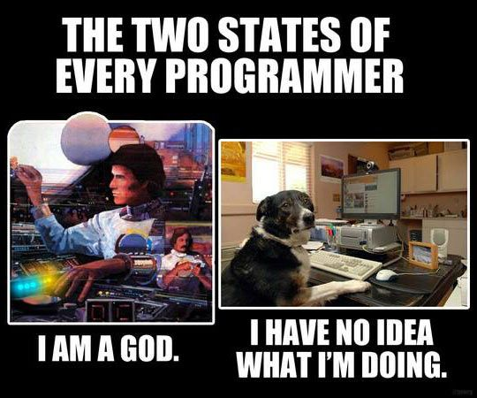
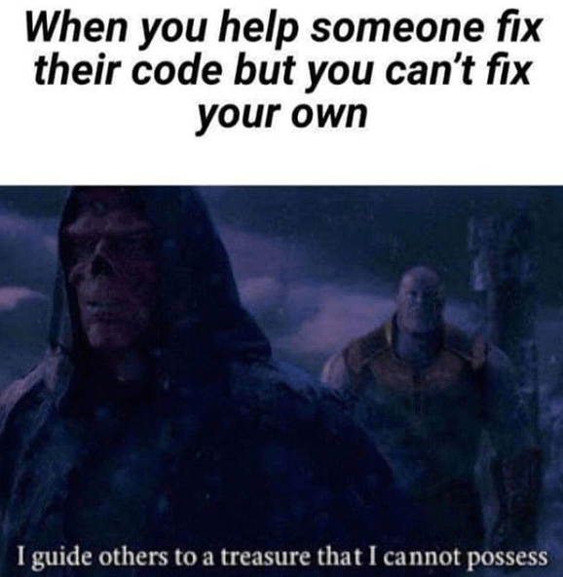
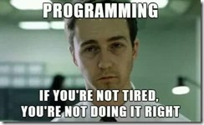
Programming is not easy
6.5

Slide 9
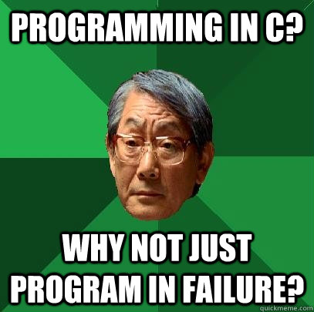
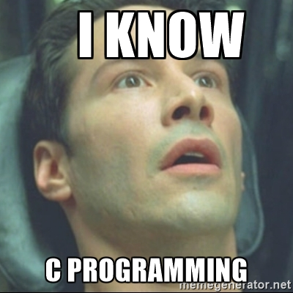
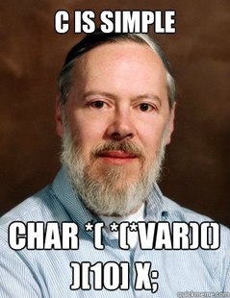
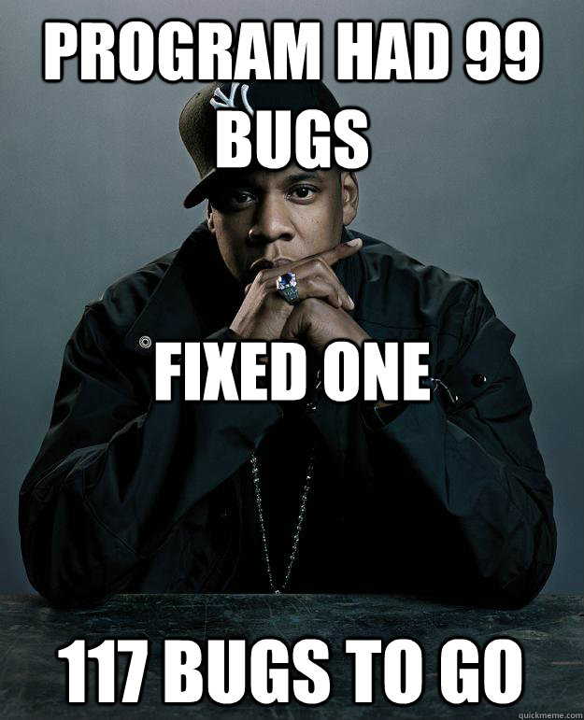
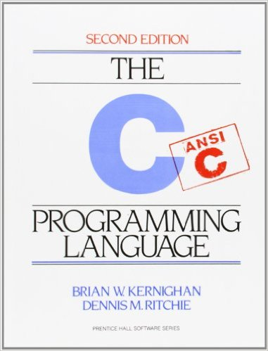
Why learn C
Negatives
C is old
C is broken
C is difficult
7
Notes:
-C is 44 years old!
-Nobody could have predicted this. Not even computer scientist Brian Kernighan, co-author of the very first book on C, which is still being printed today. (The language itself was the work of Kernighan’s co-author Dennis Ritchie, who passed away in 2011.)
“I dimly recall a conversation early on with the editors, telling them that we’d sell something like 5,000 copies of the book,” Kernighan told me in a recent interview. “We managed to do better than that. I didn’t think students would still be using a version of it as a textbook in 2014.”

Slide 10
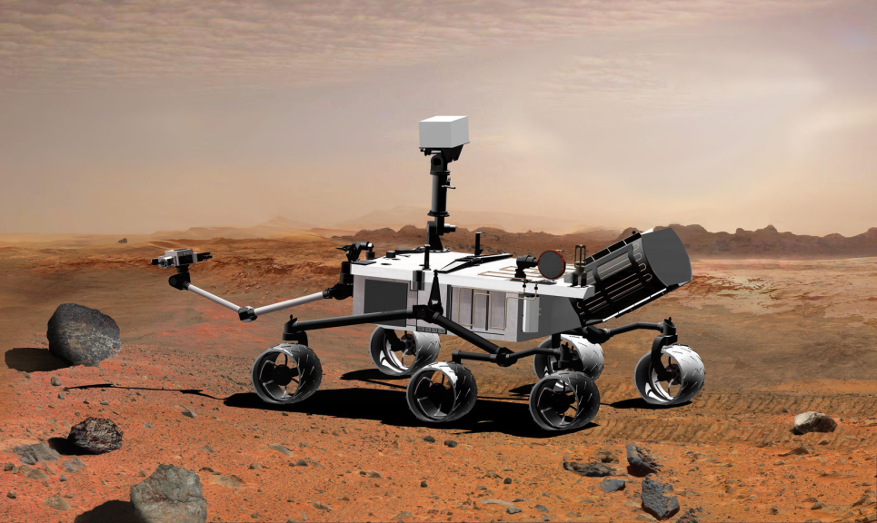
Why learn C
Positives
old and experienced
close to hardware
C is broken, but in an instructive way
mountains of legacy code
if you can code in C, you can code in anything – great first language!
8
Notes:
-C is the template for all popular languages
-Curiosity is a car-sized robotic rover exploring Gale Crater on Mars as part of NASA's Mars Science Laboratory mission (MSL).[3] Curiosity was launched from Cape Canaveral on November 26, 2011.
-More than 2 million lines of software code drove NASA’s successful Rover Curiosity landing on Mars. And, for the last two years, every single line was analyzed and scrubbed by static analysis products from Coverity, Grammatech, Semmle, and Uno.
Engineers at NASA’s Jet Propulsion Laboratory used all of the aforementioned products plus a GCC compiler and a homegrown tool to comb through the software, looking for errors or possible errors.
One of the tricky things about checking all that code — most written in C — is that sometimes it’s hard to know what to look for. “If you put software through three code reviews you’ll find stuff, and then if you put it through a fourth review, you’ll find something else. All these products all have their own strengths,’ said Gerard Holzmann, chief scientist for the JPL Lab for Reliable Software.
https://gigaom.com/2012/08/20/nasa-scrubbed-mars-rover-code-clean-over-and-over/

Slide 11
Our approach
Go slow, work on clarity, and foundation
Emphasize core programming concepts
Historical perspective
Interesting problems, mistakes
News items
New technologies, algorithmic thinking
Class discussion [grading]
9

Slide 12

Course Resources
Course Textbook
C Programming
A Modern Approach 2nd Ed [K. N. King]
Reference Books
C How to Program (7th Edition)
[Deitel & Deitel]
10

Slide 13
How to study…
Lecture slides will touch on all key concepts
Please consult reference texts [book chapters/research papers] for full details
Optional resources [e.g. research papers, online resources, videos] will be included in lecture slides to extend important concepts
11

Slide 14
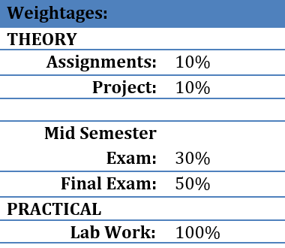
Course evaluation
12

Slide 15
Course policies
Discipline
- punctuality
- no mobile phones/laptops (exceptions)
Attendance policy (75% minimum)
Quizzes
- logistics issues
Assignments
- lots and lots and lots of them
Primary resource – course website on LMS
13

Slide 16
checklist
Register for the course on LMS
Register on MS Teams
Section C: link
Section D: link
Go over course outline
Familiarise yourself with course website
Devise a study strategy
14

Slide 17
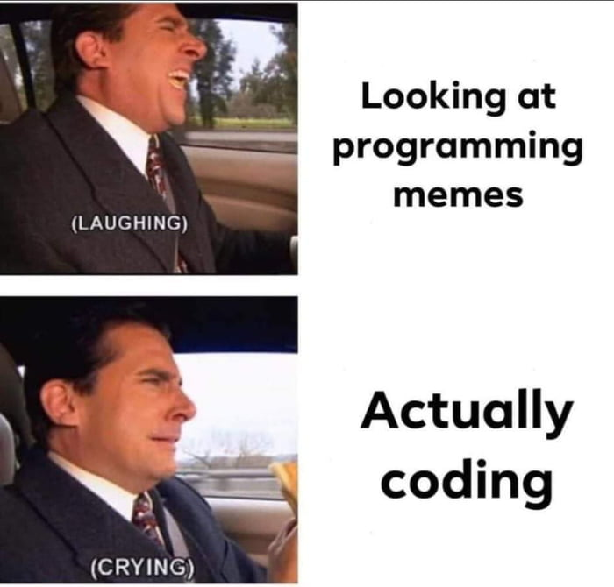
Good luck!
15

